Slide 1
Image Captioner
Final Project Presentation
110061638 呂政和
110061639 林致佑
110061641 鄧向凱

Slide 2
Table of contents
0
1
02
03
04
Overview
Implementation
Result & Issue
Reference

Slide 3



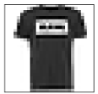
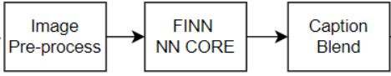

Overview
Pre-process: Resize images to the proper size.
FINN NN Core: Binarized VGG for image classification.
Caption Blend: Alpha mix the predicted label onto the input image.
dma
dma
dma

Slide 4
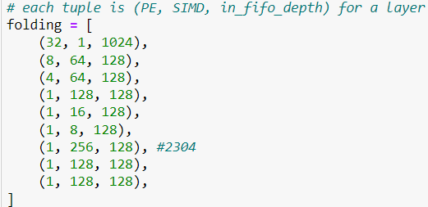
FashionMNIST NN Core Generation
Network architecture VGG-like CNN model with binarized weights and activations
Folding factor
Data loader for NN training Not just modify dataset config, write our own dataset loader to fit trainer.py

Slide 5
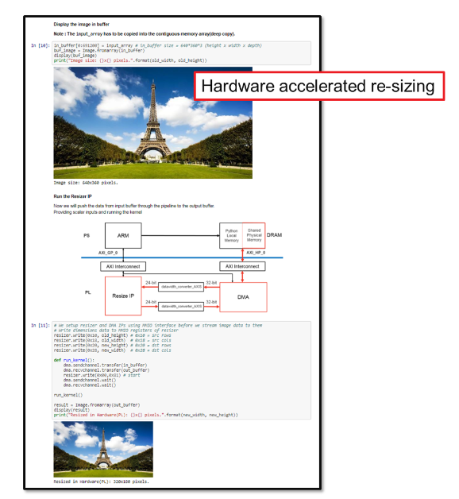
Preprocess - Resize
The preprocess kernel resizes the captured images to the size of the training data
Use the “resize” function in the Vitis Vision Library
Notes:
由於NN core的 input大小是 28*28 所以我們需要將圖片做resize才能傳進去
resize的部份我們是參考 pynq helloworld github裡面的教學修改並拿來生成IP最主要用到的就是vitis的 vision library

Slide 6
Preprocess - Resize
To resize the input picture(1280×720) into proper size(28x28).
Instead of using software(Python OpenCV resize), we try to use functions from Vitis vision library to accelerate the computer vision functions on an FPGA device.
We use xf::cv::resize function to resize the picture.

Slide 7
Preprocess - Resize
The image containers for Vitis vision library functions are xf::cv::Mat objects. After streaming image from DMA, we need to transform the image data into xf::cv::Mat objects.

Slide 8
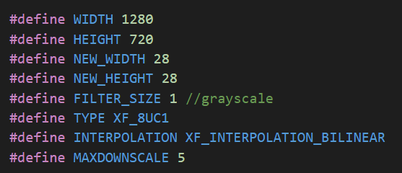
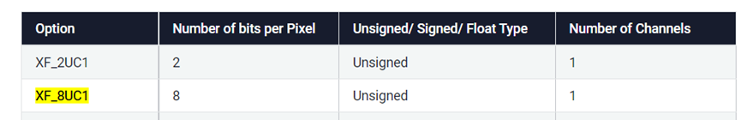


Preprocess - Resize
After studying xf::cv::resize function, we set the parameters of resize function.

Slide 9
Caption Blend
Load in an original image.
According to the predicted label of the classification output, the kernel generates the image of the corresponding label.
Mix the label image onto the input image.
Notes:
Caption blend 是我們流程中最重要的一環 我們會將NN core辨識出來的結果和對應的英文字母合成至圖片的上方

Slide 10
Caption Blend
First, we have to generate the label image, which is based on the computation result from NN core. If it reports “2”, the windex function will generate label image “pullover”.
In wgen_mix function, we mix the label image onto the input image.

Slide 11
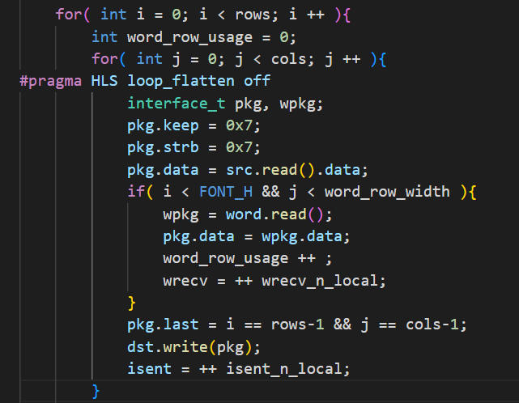
Caption Blend
In wgen_mix function, we mix the label image onto the input image.

Slide 12
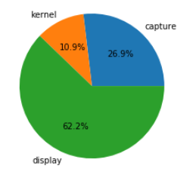
Performance evaluation
avg read latency: 0.059 s
avg kernel latency: 0.024 s
avg display latency: 0.136 s
Notes:
餵多張圖片 算平均時間
Capture 把圖片讀近來丟進 FPGA input buffer
Kernel FPGA runtime
Display 顯示在host/jupyter notebook時間

Slide 13
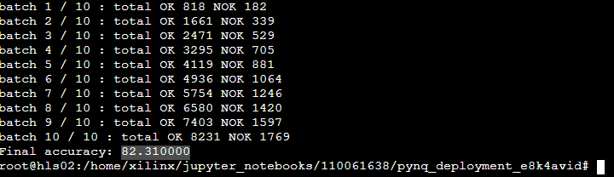
Result - NN Core Accuracy
The accuracy after training on Brevitas
The accuracy satisfy the goal we set in proposal
The accuracy applys onto pynq-Z2 is 82.31%

Slide 14
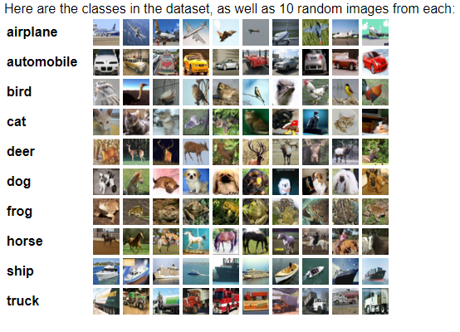
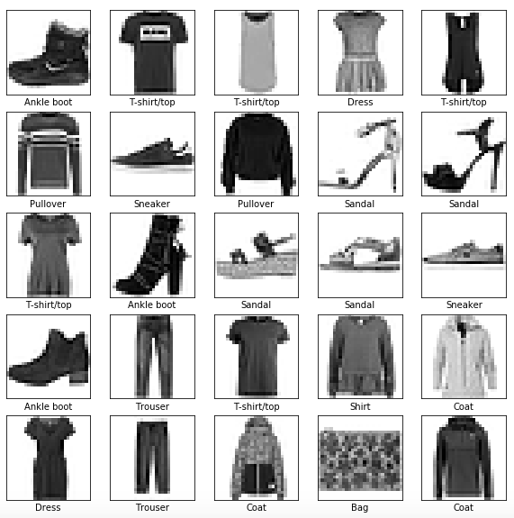
Issue encountered
The difference between Cifar10 and FashionMnist
Image size 32x32 v.s. 28x28
Channel number 3 v.s. 1

Slide 15
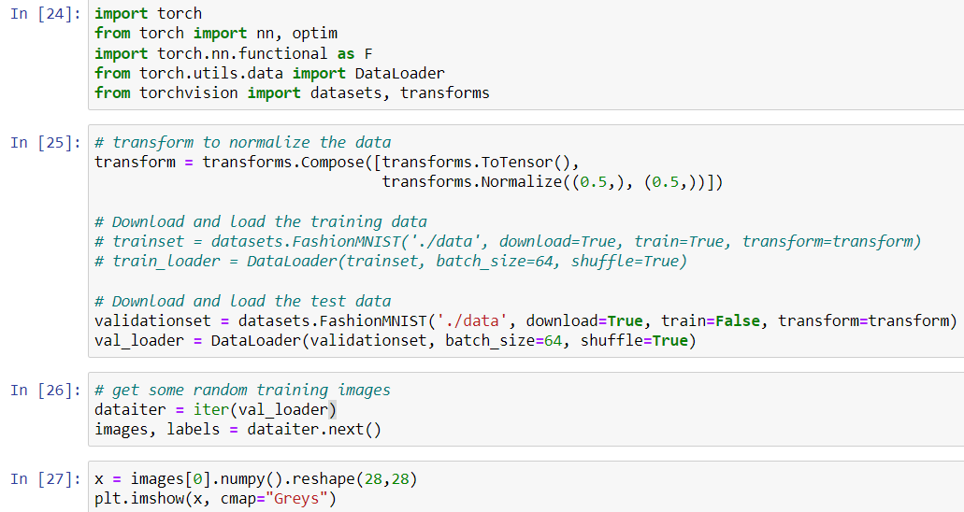
Issue encountered
The difference between Cifar10 and FashionMnist
Dataset download

Slide 16
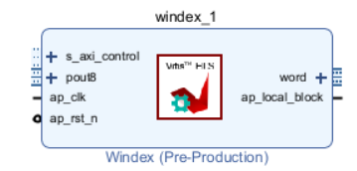
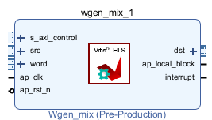
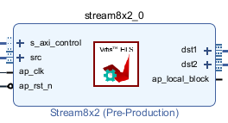
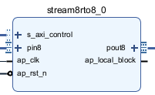
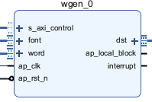
Issue encountered
IPs generation
Add the file into Vitis, after synthesis, we can export RTL like Lab1.
Windex, wgen, wgen_mix, stream8rto8, stream8x2, resize

Slide 17
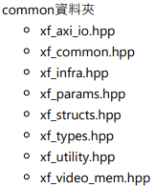
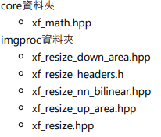
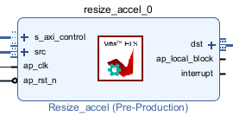
Issue encountered
IPs generation
Missing files while generating IP.
Add the file into Vitis, after synthesis, we can export RTL like Lab1.

Slide 18
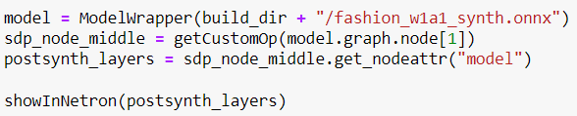
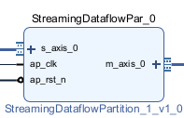

Issue encountered
NN core IP generation
Refer to the lab before, we didn’t find any code to produce the IP
Finn github from Xilinx

Slide 19
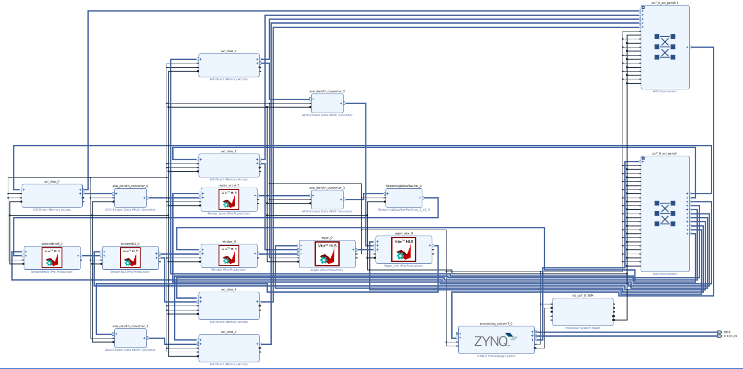
Issue encountered
After connect all the IPs

Slide 20
Issue encountered
Vivado under Windows
Path length exceeds 260-Byte maximum allowed by Windows
We use linux to solve this problem.
Board file added

Slide 21
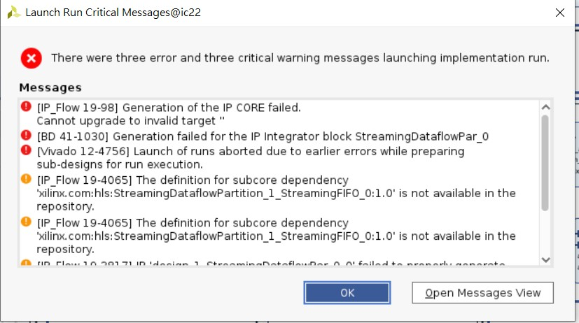
Issue encountered
Vivado under Linux
Unsolved error

Slide 22
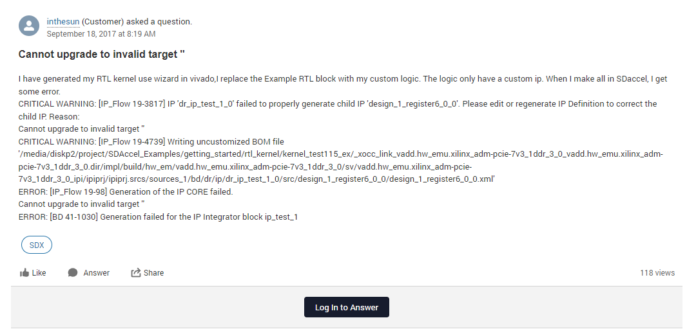
Issue encountered
We turn to Xilinx for help.

Slide 23
Reference
https://github.com/Xilinx/PYNQ-HelloWorld
https://xilinx.github.io/Vitis_Libraries/vision
https://github.com/Xilinx/finn
https://developer.arm.com/documentation/ihi0051/a/
https://github.com/Xilinx/finn/blob/main/notebooks/end2end_example/bnn-pynq/cnv_end2end_example.ipynb

Slide 24
Thank You

